Slide 1
Ashish Jeffery J
Final Project
3/21/2024 Annual Review

Slide 2
PROJECT TITLE
Face Recognition Attendance System
3/21/2024 Annual Review

Slide 3


AGENDA
PROBLEM STATEMENT
PROJECT OVERVIEW
WHO ARE THE END USERS?
YOUR SOLUTION AND ITS VALUE PROPOSITION
THE WOW IN YOUR SOLUTION
MODELLING
RESULTS
3/21/2024 Annual Review

Slide 4

PROBLEM STATEMENT
Design and implement a robust and efficient face recognition system capable of accurately identifying individuals and recording their attendance in various settings such as classrooms, workplaces, or events. The system should be able to handle variations in lighting conditions, facial expressions, and occlusions while maintaining high accuracy and efficiency. Additionally, it should provide a user-friendly interface for administrators to manage attendance records and monitor system performance."
3/21/2024 Annual Review

Slide 5

PROJECT OVERVIEW
Objective: Automate attendance recording through facial recognition for enhanced efficiency and accuracy.
Data Collection: Gather diverse datasets of labeled facial images for training.
Data Preprocessing: Standardize images through resizing, normalization, and augmentation.
Model Selection: Choose a suitable deep learning architecture like CNNs (e.g., VGG, ResNet, FaceNet).
Model Training: Train the selected model using preprocessed data, employing transfer learning if necessary.
Implementation: Develop the system to detect faces, recognize individuals, and record attendance.
User Interface: Create an intuitive interface for administrators to manage attendance records and monitor system performance.
Testing and Evaluation: Assess the system's accuracy, efficiency, and robustness across different scenarios.
Deployment: Deploy the system in classrooms, workplaces, or events for practical use.
Maintenance and Updates: Ensure regular maintenance and updates to optimize system performance and address any issues.
3/21/2024 Annual Review

Slide 6
WHO ARE THE END USERS?
Educational Institutions: Teachers, professors, and administrative staff who need to track student attendance in classrooms and lecture halls.
Corporate Offices: HR departments and managers who need to monitor employee attendance and punctuality.
Event Organizers: Staff responsible for managing attendance at conferences, seminars, workshops, and other events.
Security Personnel: Individuals tasked with monitoring access to restricted areas in facilities or buildings.
Government Agencies: Authorities who need to track attendance for official purposes, such as immigration checkpoints or government facilities.
Any Organization Requiring Attendance Tracking: Any organization or institution that needs to keep track of attendance for various reasons, such as compliance, payroll, or security.
3/21/2024 Annual Review

Slide 7

YOUR SOLUTION AND ITS VALUE PROPOSITION
Solution: Our face recognition attendance system offers an automated and efficient way to track attendance using facial recognition technology.
Value Proposition:
Accuracy: Provides highly accurate attendance tracking by recognizing individuals based on their unique facial features, minimizing errors associated with traditional methods.
Efficiency: Streamlines the attendance-taking process, saving time and resources for educators, administrators, and HR personnel.
Convenience: Eliminates the need for manual attendance sheets or cards, offering a hassle-free experience for both administrators and attendees.
Security: Enhances security by ensuring that only authorized individuals can gain access, reducing the risk of unauthorized entry or fraudulent attendance.
Insightful Analytics: Generates attendance reports and insights, enabling organizations to analyze attendance trends and make informed decisions.
3/21/2024 Annual Review

Slide 8

THE WOW IN YOUR SOLUTION
Instant Recognition: Attendees are identified within seconds upon entering the system's field of view, offering a seamless and quick check-in experience.
Hands-Free Operation: Requires no physical interaction from attendees, allowing for a contactless and hygienic attendance tracking solution, especially in hygiene-sensitive environments.
Adaptive Learning: The system continuously improves its accuracy over time through machine learning algorithms, ensuring reliable performance even in challenging conditions.
Real-Time Alerts: Administrators receive instant notifications in case of anomalies, such as unauthorized access attempts or discrepancies in attendance records, enabling prompt action.
Customizable Features: Flexible configuration options allow organizations to tailor the system to their specific needs, integrating additional functionalities like temperature screening or access control.
3/21/2024 Annual Review

Slide 9
MODELLING
Data Collection: Gather a dataset of labeled facial images representing individuals whose attendance needs to be tracked.
Model Selection: Choose a pre-trained deep learning model suitable for face recognition tasks, such as VGG-Face, FaceNet, or OpenFace.
Model Adaptation:
Remove the final classification layers of the pre-trained model.
Add new layers for classification or feature extraction tailored to the attendance system's needs.
Training:
Fine-tune the adapted model on your dataset to learn to recognize individuals' faces.
Use techniques like transfer learning to leverage the pre-trained model's knowledge.
Validation and Testing:
Evaluate the trained model's performance on a validation set to ensure it generalizes well.
Test the model on unseen data to assess its accuracy and robustness.
Optimization:
Tune hyperparameters like learning rate and batch size to optimize model performance.
Consider regularization techniques to prevent overfitting.
3/21/2024 Annual Review

Slide 10
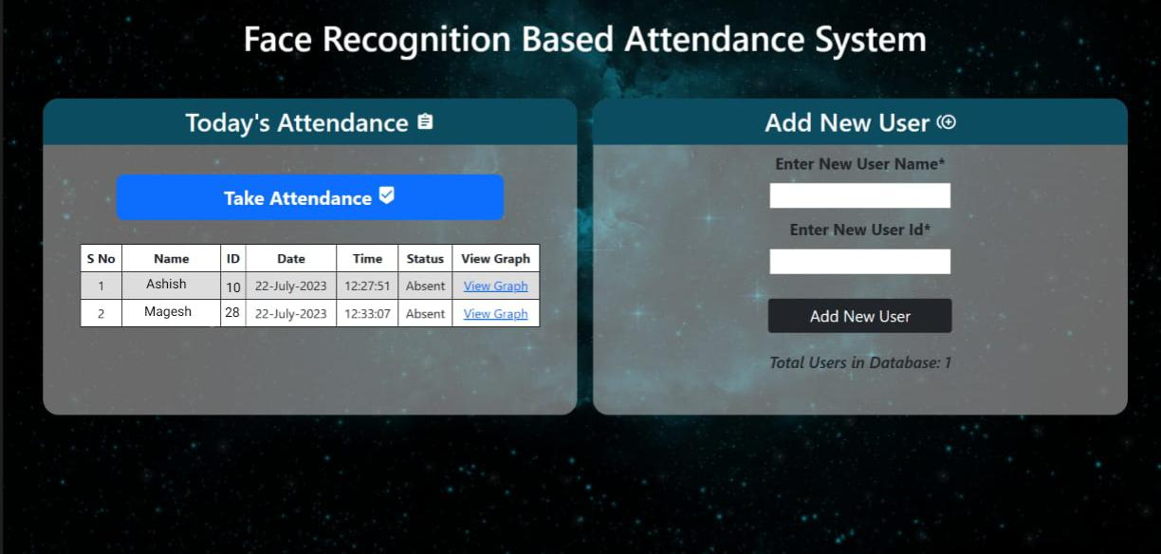
RESULTS
In summary, the face recognition attendance system using deep learning offers a reliable and efficient way to automate attendance tracking. By leveraging advanced algorithms, we achieve high accuracy and streamline the process for users. With its user-friendly interface and robust performance, the system significantly improves efficiency and security. Overall, it presents a straightforward and effective solution for modern attendance management needs.

